Slide 1

UNIT-V

Slide 2

How to find mathematical model, called a state-space representation, for a linear, time-invariant system
How to convert between transfer function and state space models

Slide 3

Alternative method of modeling a system than
  Differential / difference equations
  Transfer functions
Uses matrices and vectors to represent the system parameters and variables
In control engineering, a state space representation is a mathematical model of a physical system as a set of input, output and state variables related by first-order differential equations. To abstract from the number of inputs, outputs and states, the variables are expressed as vectors.

Slide 4

Easier for computers to perform matrix algebra
  e.g. MATLAB does all computations as matrix math
Handles multiple inputs and outputs
Provides more information about the system
  Provides knowledge of internal variables (states)
Primarily used in complicated, large-scale systems

Slide 5

State- The state of a dynamic system is the smallest set of variables (called state variables) such that knowledge of these variables at t=t0 , together with knowledge of the input for t ≥ t0 , completely determines the behavior of the system for any time t to t0 .
Note that the concept of state is by no means limited to physical systems. It is applicable to biological systems, economic systems, social systems, and others.

Slide 6
State Variables:
The state variables of a dynamic system are the variables making up the smallest set of variables that determine the state of the dynamic system.
If at least n variables x1, x2, …… , xn are needed to completely describe the behavior of a dynamic system (so that once the input is given for t ≥ t0 and the initial state at t=t0 is specified, the future state of the system is completely determined), then such n variables are a set of state variables.

Slide 7
State Vector:
A vector whose elements are the state variables.
If n state variables are needed to completely describe the behavior of a given system, then these n state variables can be considered the n components of a vector x. Such a vector is called a state vector.
A state vector is thus a vector that determines uniquely the system state x(t) for any time t≥ t0, once the state at t=t0 is given and the input u(t) for t ≥ t0 is specified.

Slide 8
State Space:
The n-dimensional space whose coordinate axes consist of the x1 axis, x2 axis, ….., xn axis, where x1, x2,…… , xn are state variables, is called a state space.
"State space" refers to the space whose axes are the state variables. The state of the system can be represented as a vector within that space.

Slide 9
State-Space Equations. In state-space analysis we are concerned with three types of variables that are involved in the modeling of dynamic systems: input variables, output variables, and state variables.
The number of state variables to completely define the dynamics of the system is equal to the number of integrators involved in the system.
Assume that a multiple-input, multiple-output system involves n integrators. Assume also that there are r inputs u₁(t), u₂(t),……. u_{r}(t) and m outputs y₁(t), y₂(t), …….. y_{m}(t).

Slide 10
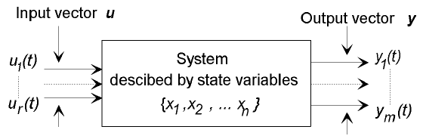
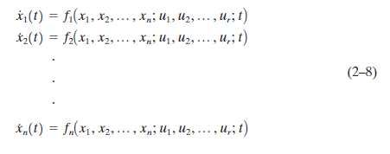
Define n outputs of the integrators as state variables: x₁(t), x₂(t), ……… x_{n}(t). Then the system may be described by

Slide 11
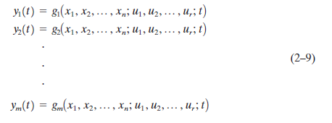
The outputs y₁(t), y₂(t), ……… y_{m}(t) of the system may be given by

Slide 12
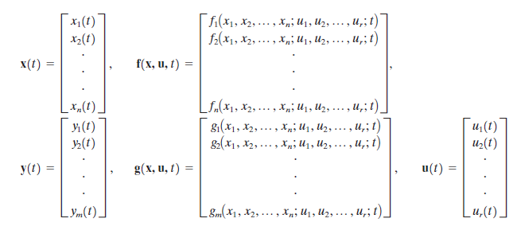
If we define

Slide 13

then Equations (2–8) and (2–9) become
where Equation (2–10) is the state equation and Equation (2–11) is the output equation. If vector functions f and/or g involve time t explicitly, then the system is called a time varying system.

Slide 14

If Equations (2–10) and (2–11) are linearized about the operating state, then we have the following linearized state equation and output equation:

Slide 15
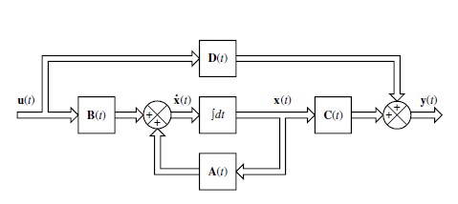
A(t) is called the state matrix,
B(t) the input matrix,
C(t) the output matrix, and
D(t) the direct transmission matrix.
A block diagram representation of Equations (2–12) and (2–13) is shown in Figure

Slide 16

If vector functions f and g do not involve time t explicitly then the system is called a time-invariant system. In this case, Equations (2–12) and (2–13) can be simplified to
Equation (2–14) is the state equation of the linear, time-invariant system and
Equation (2–15) is the output equation for the same system.

Slide 17



The "transfer function" of a continuous time-invariant linear state-space model can be derived in the following way:
First, taking the Laplace transform of
Yields

Slide 18
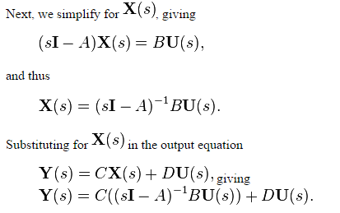

Slide 19
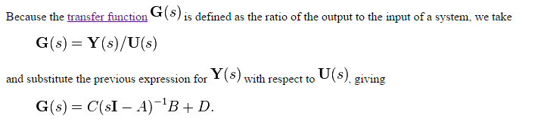

Slide 20
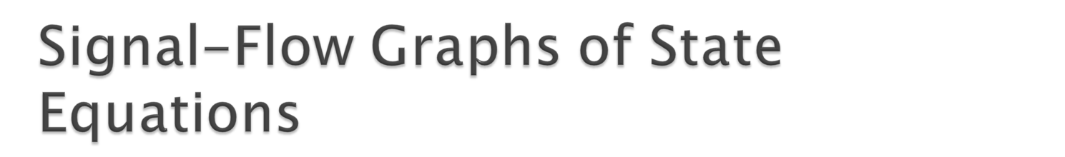
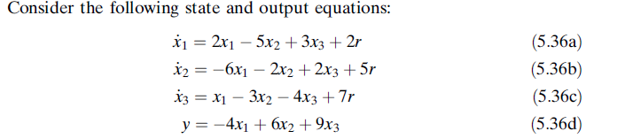

Slide 21
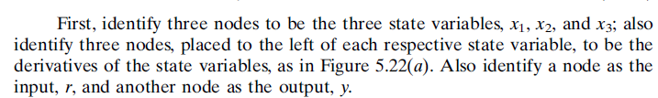


Slide 22
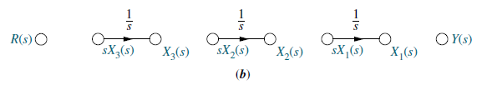

Slide 23
Then using Eqs. (5.36), feed to each node the indicated signals.
For example, from Eq. (5.36a),
as shown in Figure 5.22(c).
Similarly, as shown in Figure 5.22(d),
as shown in Figure 5.22(e).
Finally, using Eq. (5.36d), the output,
as shown in Figure 5.19(f ), the final phase-variable representation, where the state variables are the outputs of the integrators.

Slide 24
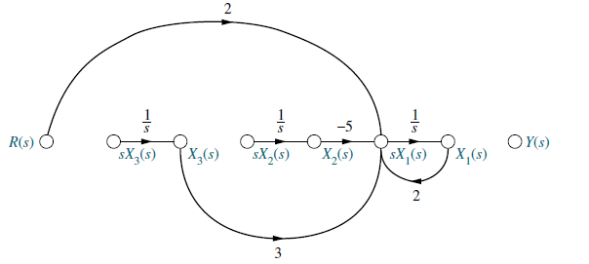
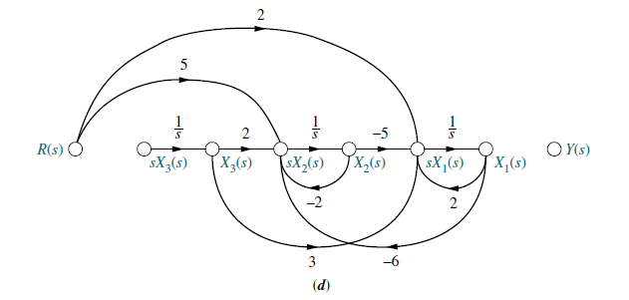

Slide 25
